Slide 1
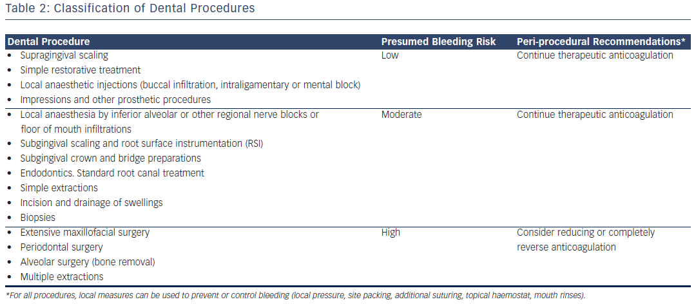
Tsolka P
Table 2: Classification of Dental Procedures
Citation: Arrhythmia & Electrophysiology Review 2014;3(2):85–9
https://doi.org/10.15420/aer.2014.3.2.85

