Slide 1
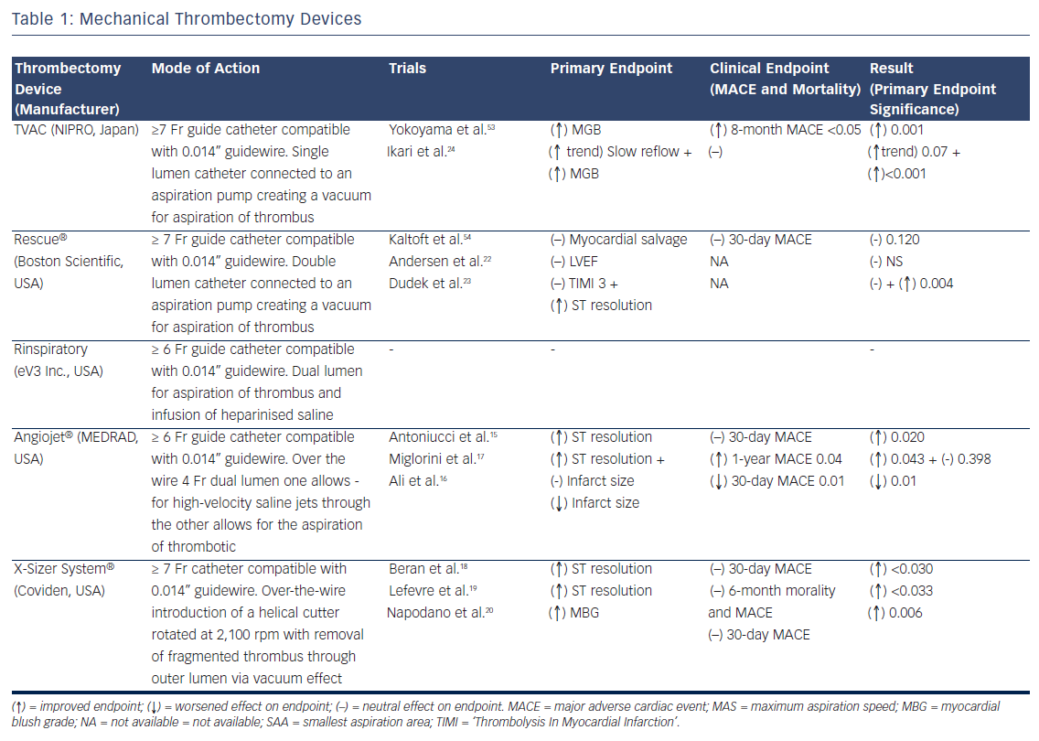
Rathod KS, Hamshere SM, Choudhury TR, Jones DA, Mathur A
Table 1: Mechanical Thrombectomy Devices
Citation: Interventional Cardiology Review 2014;9(2):102–7
https://doi.org/10.15420/icr.2011.9.2.102

