Slide 1
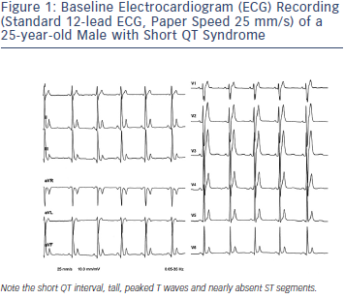
Rudic B, Schimpf R, Borggrefe M
Figure 1: Baseline Electrocardiogram (ECG) Recording (Standard 12-lead ECG, Paper Speed 25 mm/s) of a 25-year-old Male with Short QT Syndrome
Citation: Arrhythmia & Electrophysiology Review 2014;3(2):76–9
https://doi.org/10.15420/aer.2014.3.2.76

