Slide 1
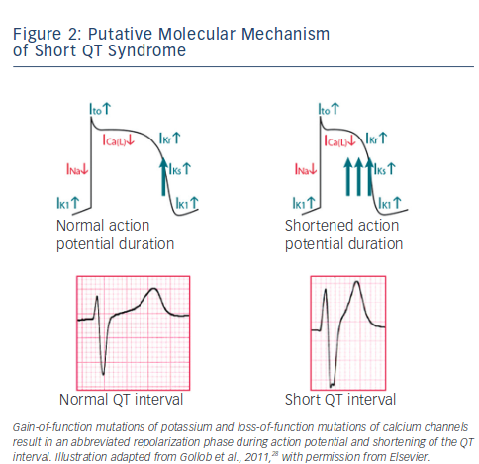
Rudic B, Schimpf R, Borggrefe M
Short QT Syndrome – Review of Diagnosis and Treatment
Citation: Arrhythmia & Electrophysiology Review 2014;3(2):76–9
https://doi.org/10.15420/aer.2014.3.2.76

