Slide 1
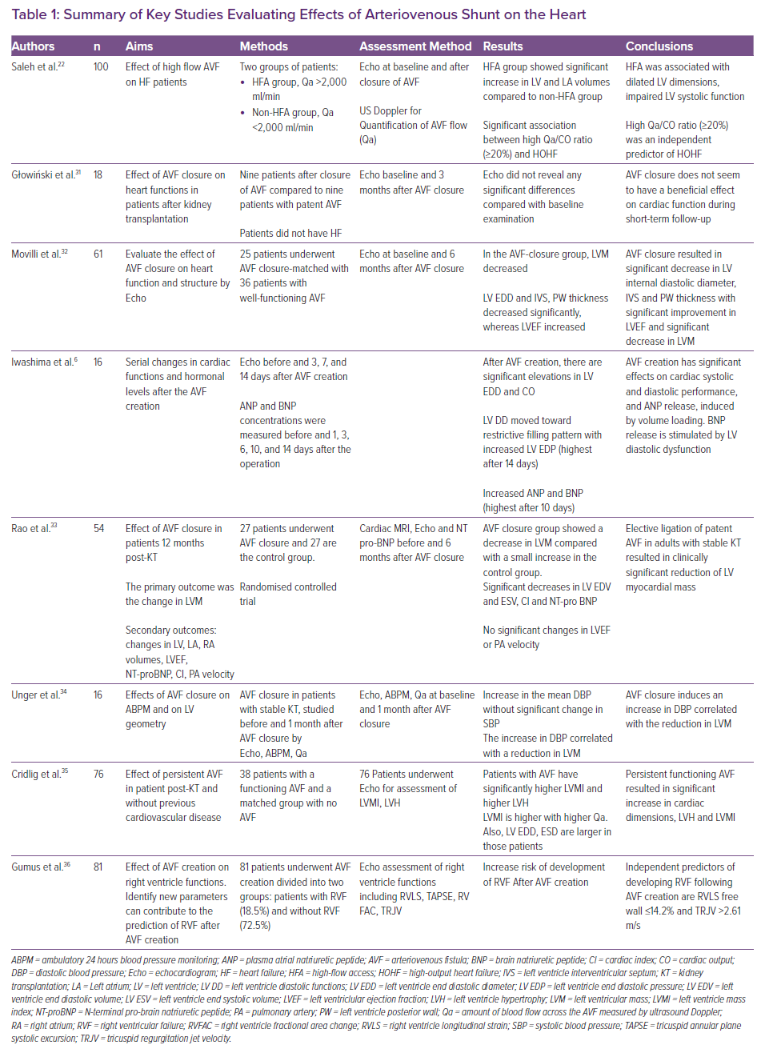
Soliman M, Attallah N, Younes H, Park WS, Bader F
Summary of Key Studies Evaluating Effects of Arteriovenous Shunt on the Heart
Citation: Cardiac Failure Review 2022;8:e05.
https://doi.org/10.15420/cfr.2021.12

