Slide 1
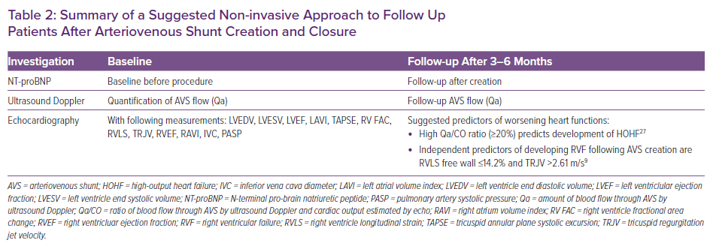
Soliman M, Attallah N, Younes H, Park WS, Bader F
Summary of a Suggested Non-invasive Approach to Follow Up Patients After Arteriovenous Shunt Creation and Closure
Citation: Cardiac Failure Review 2022;8:e05.
https://doi.org/10.15420/cfr.2021.12

