Slide 1
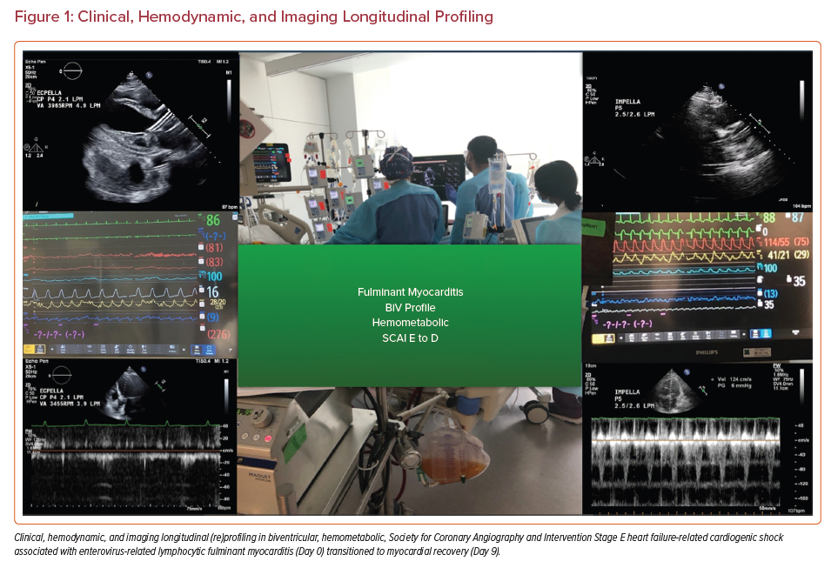
Hernandez-Montfort J, Miranda D, Randhawa VK, Sleiman J, de Armas YS, Lewis A, Taimeh Z, Alvarez P, Cremer P, Perez-Villa B, Navas V, Hakemi E, Velez M, Hernandez-Mejia L, Sheffield C, Brozzi N, Cubeddu R, Navia JL, Estep JD
Clinical, Hemodynamic, and Imaging Longitudinal Profiling
Citation: US Cardiology Review 2022;16:e05.
https://doi.org/10.15420/usc.2021.12

