Slide 1
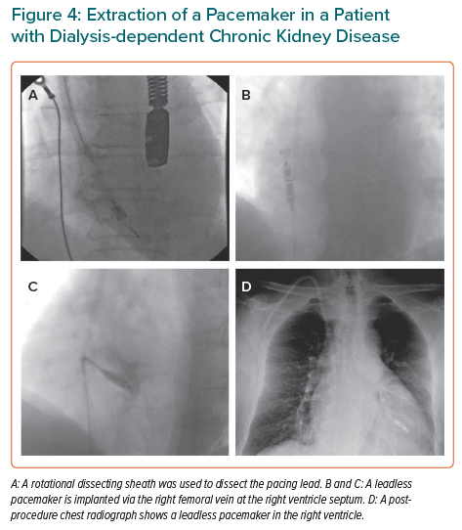
Akhtar Z, Leung LW, Kontogiannis C, Chung I, Waleed KB, Gallagher MM
Extraction of a Pacemaker in a Patient with Dialysis-dependent Chronic Kidney Disease
Citation: European Cardiology Review 2022;17:e05.
https://doi.org/10.15420/ecr.2021.52

