Slide 1
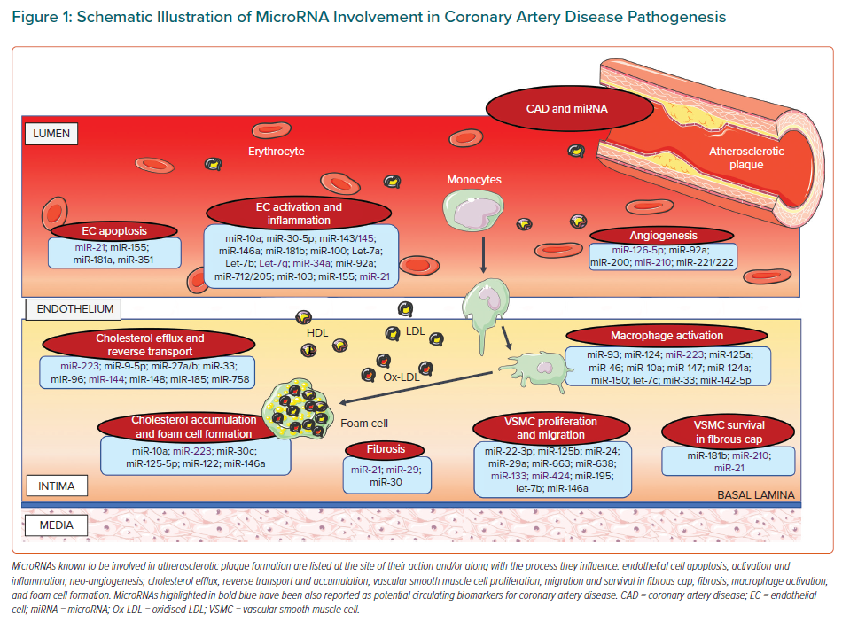
Vavassori C, Cipriani E, Colombo GI
Schematic Illustration of MicroRNA Involvement in Coronary Artery Disease Pathogenesis
Citation: European Cardiology Review 2022;17:e06.
https://doi.org/10.15420/ecr.2021.47

