Slide 1
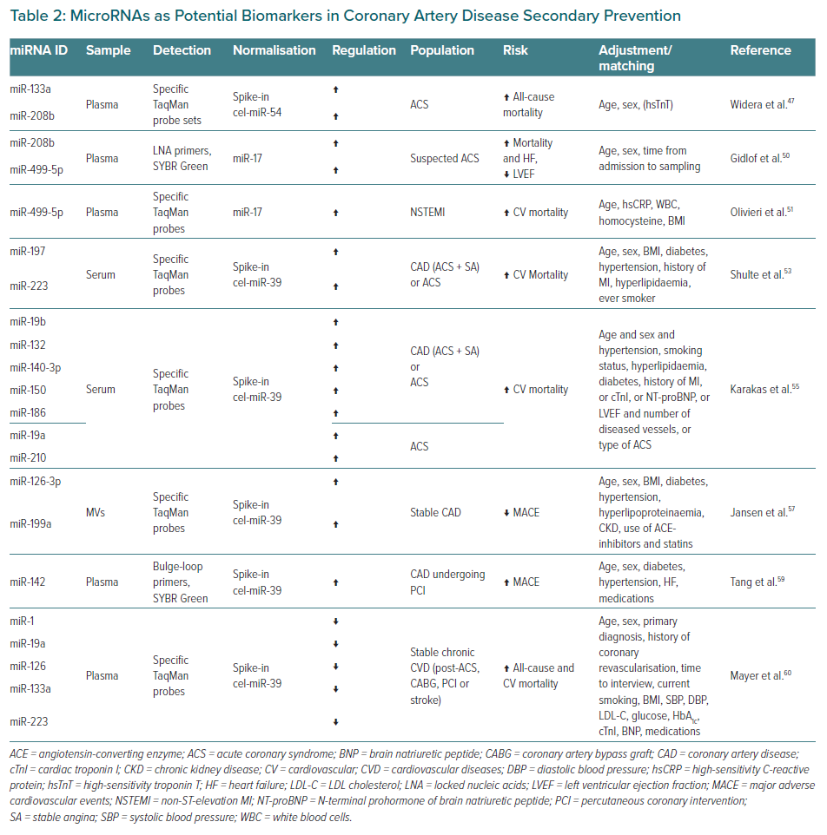
Vavassori C, Cipriani E, Colombo GI
MicroRNAs as Potential Biomarkers in Coronary Artery Disease Secondary Prevention
Citation: European Cardiology Review 2022;17:e06.
https://doi.org/10.15420/ecr.2021.47

