Slide 1
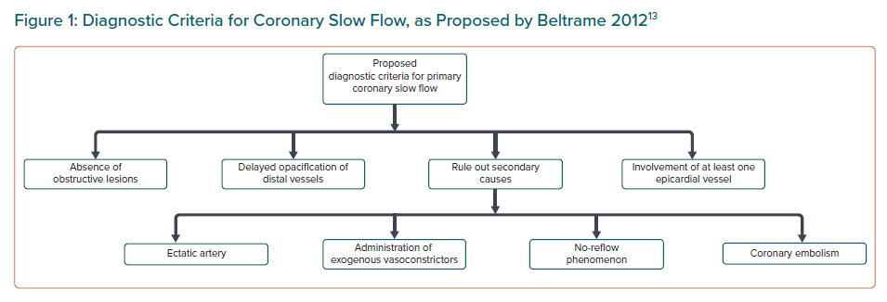
Aparicio A, Cuevas J, Morís C, Martin M
Diagnostic Criteria for Coronary Slow Flow, as Proposed by Beltrame 2012
Citation: European Cardiology Review 2022;17:e08.
https://doi.org/10.15420/ecr.2021.46

