Slide 1
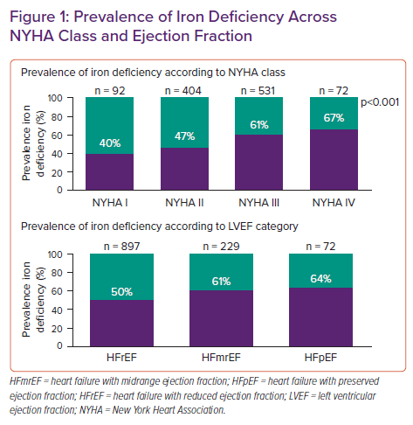
Martens P
Prevalence of Iron Deficiency Across NYHA Class and Ejection Fraction
Citation: Cardiac Failure Review 2022;8:e06.
https://doi.org/10.15420/cfr.2021.26

