Slide 1
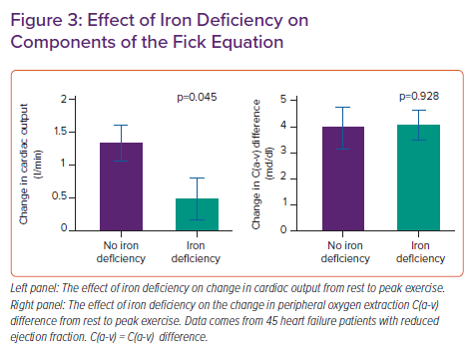
Martens P
Effect of Iron Deficiency on Components of the Fick Equation
Citation: Cardiac Failure Review 2022;8:e06.
https://doi.org/10.15420/cfr.2021.26

