Slide 1
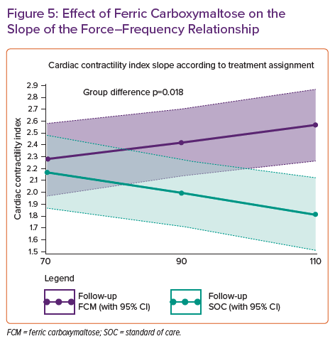
Martens P
Effect of Ferric Carboxymaltose on the Slope of the Force–Frequency Relationship
Citation: Cardiac Failure Review 2022;8:e06.
https://doi.org/10.15420/cfr.2021.26

