Slide 1
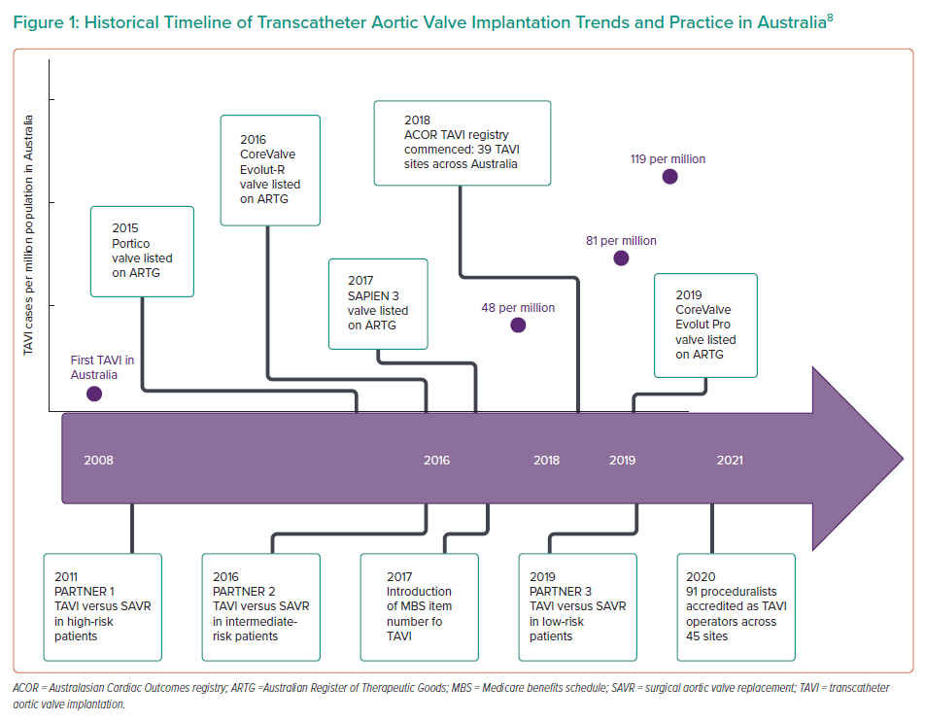
Gray R, Sarathy K
Historical Timeline of Transcatheter Aortic Valve Implantation Trends and Practice in Australia
Citation: Interventional Cardiology 2022;17:e03.
https://doi.org/10.15420/icr.2021.27

