Slide 1
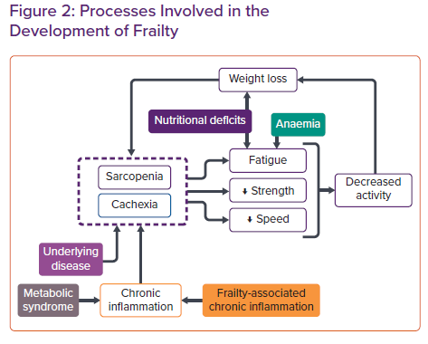
Salmon T, Essa H, Tajik B, Isanejad M, Akpan A, Sankaranarayanan R
Processes Involved in the Development of Frailty
Citation: Cardiac Failure Review 2022;8:e07.
https://doi.org/10.15420/cfr.2021.29

