Slide 1
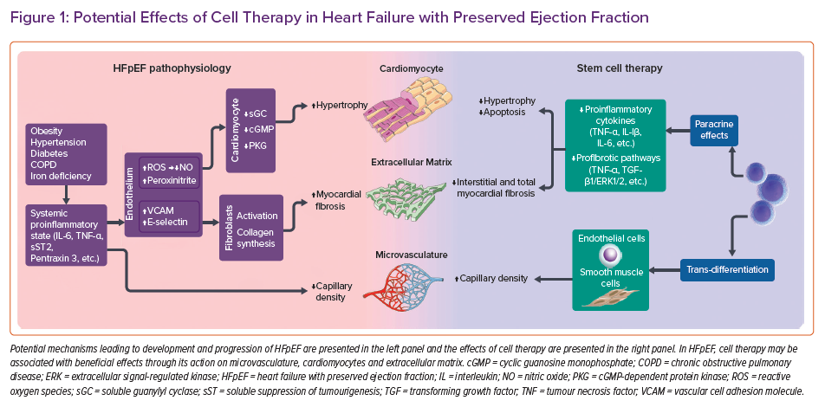
Frljak S, Poglajen G, Vrtovec B
Potential Effects of Cell Therapy in Heart Failure with Preserved Ejection Fraction
Citation: Cardiac Failure Review 2022;8:e08.
https://doi.org/10.15420/cfr.2021.21

