Slide 1

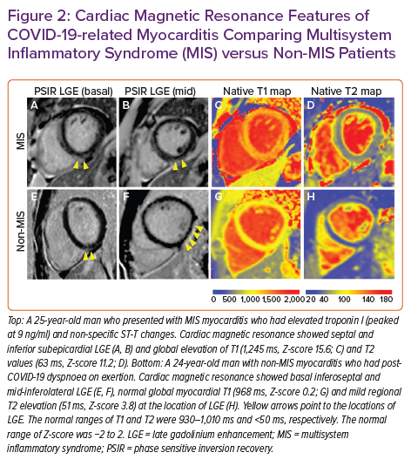
Clark DE, Aggarwal SK, Phillips NJ, Soslow JH, Dendy JM, Hughes SG
Cardiac Magnetic Resonance Features of COVID-19-related Myocarditis Comparing Multisystem Inflammatory Syndrome (MIS) versus Non-MIS Patients
Citation: Cardiac Failure Review 2022;8:e09.
https://doi.org/10.15420/cfr.2021.20

