Slide 1
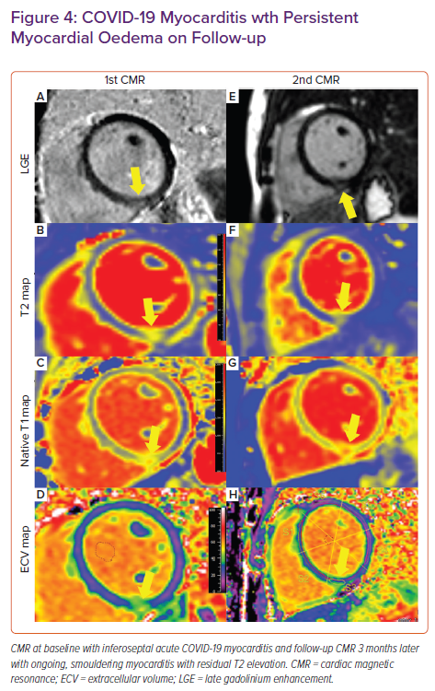
Clark DE, Aggarwal SK, Phillips NJ, Soslow JH, Dendy JM, Hughes SG
COVID-19 Myocarditis wth Persistent Myocardial Oedema on Follow-up
Citation: Cardiac Failure Review 2022;8:e09.
https://doi.org/10.15420/cfr.2021.20

