Slide 1
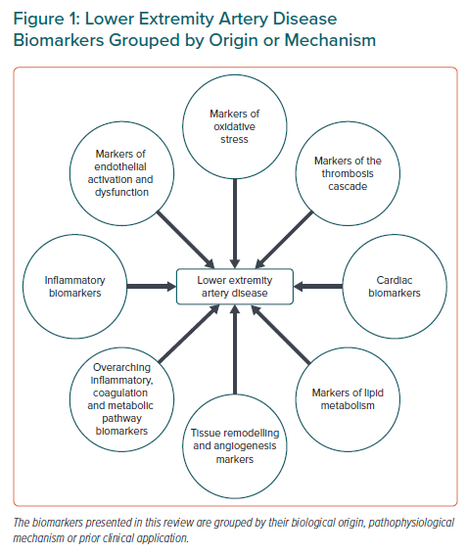
Ziegler L, Hedin U, Gottsäter A
Lower Extremity Artery Disease Biomarkers Grouped by Origin or Mechanism
Citation: European Cardiology Review 2022;17:e09.
https://doi.org/10.15420/ecr.2021.58

