Slide 1
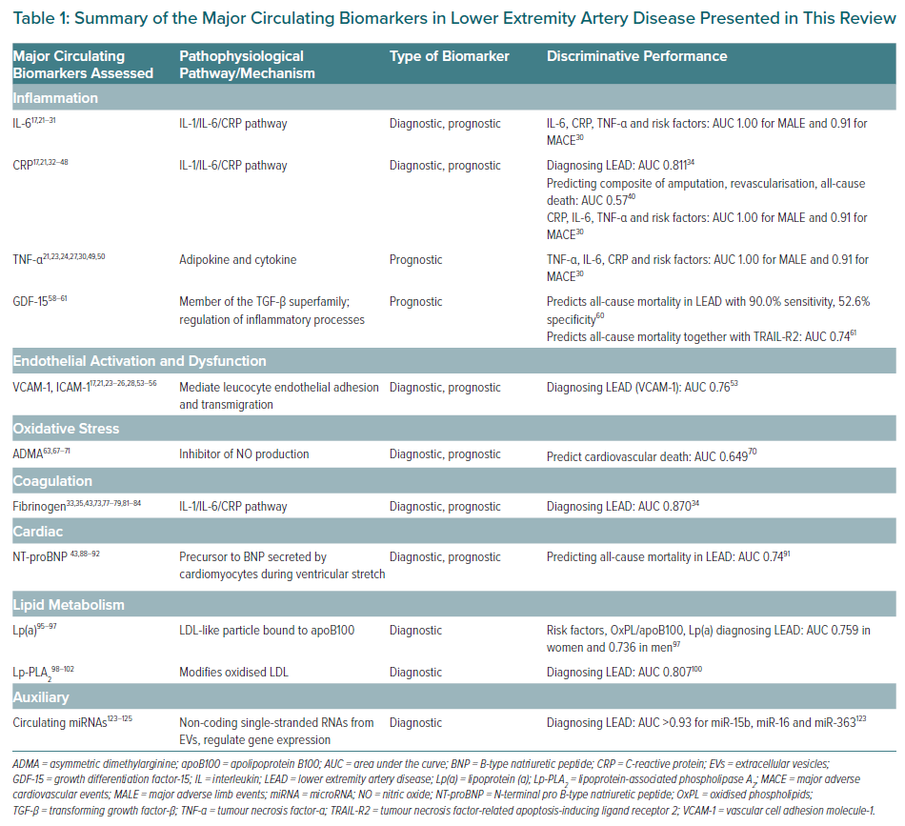
Ziegler L, Hedin U, Gottsäter A
Summary of the Major Circulating Biomarkers in Lower Extremity Artery Disease Presented in This Review
Citation: European Cardiology Review 2022;17:e09.
https://doi.org/10.15420/ecr.2021.58

