Slide 1
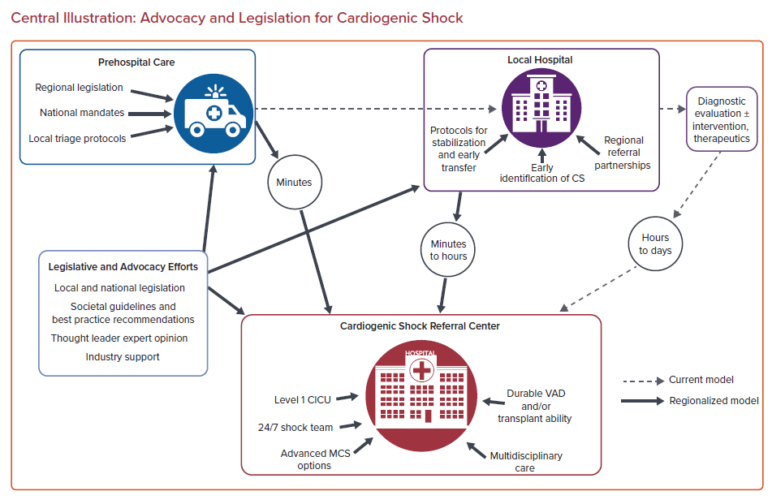
Gorder K, Rudick S, Smith TD
Central Illustration: Advocacy and Legislation for Cardiogenic Shock
Citation: US Cardiology Review 2022;16:e06.
https://doi.org/10.15420/usc.2021.14

