Slide 1
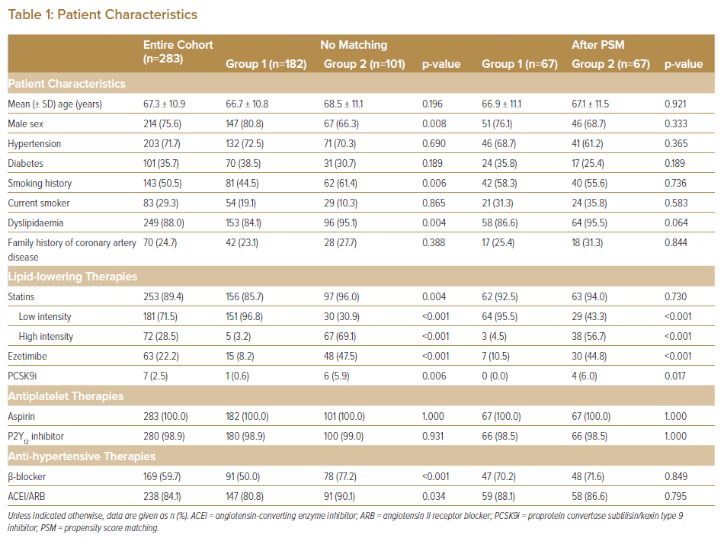
Yamada R, Kume T, Okamoto H, Yamashita M, Koto S, Kamisaka K, Sasahira Y, Sudo Y, Enzan A, Tamada T, Koyama T, Imai K, Nishi T, Neishi Y, Uemura S
Patient Characteristics
Citation: Journal of Asian Pacific Society of Cardiology 2022;1:e06.
https://doi.org/10.15420/japsc.2021.21

