Slide 1
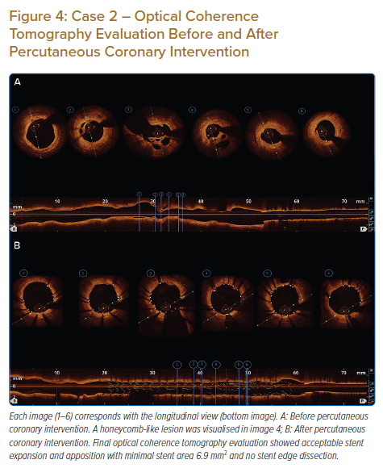
Yahya AF, Adams I, Saboe A
Case 2 – Optical Coherence Tomography Evaluation Before and After Percutaneous Coronary Intervention
Citation: Journal of Asian Pacific Society of Cardiology 2022;1:e07.
https://doi.org/10.15420/japsc.2021.08

