Slide 1
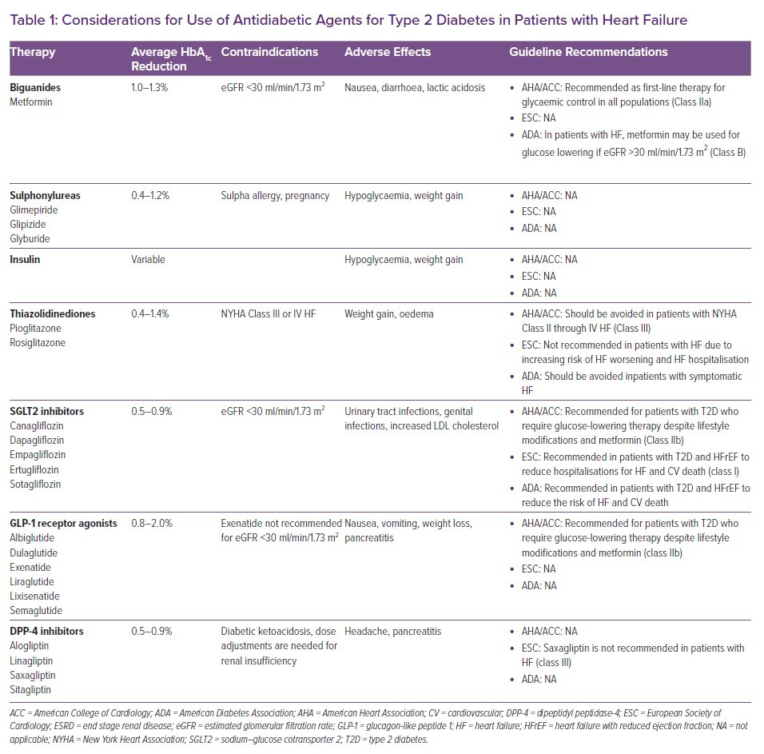
Agarwalla A, Gruen J, Peters C, Sinnenberg L, Owens AT, Reza N
Considerations for Use of Antidiabetic Agents for Type 2 Diabetes in Patients with Heart Failure
Citation: Cardiac Failure Review 2022;8:e10.
https://doi.org/10.15420/cfr.2021.31

