Slide 1
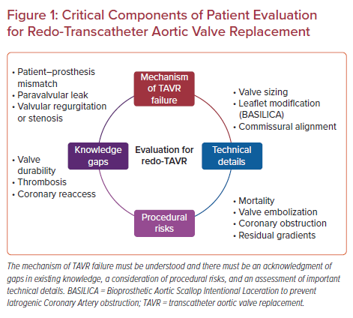
Perrin N, Asgar AW
Critical Components of Patient Evaluation for Redo-Transcatheter Aortic Valve Replacement
Citation: US Cardiology Review 2022;16:e07.
https://doi.org/10.15420/usc.2021.18

