Slide 1
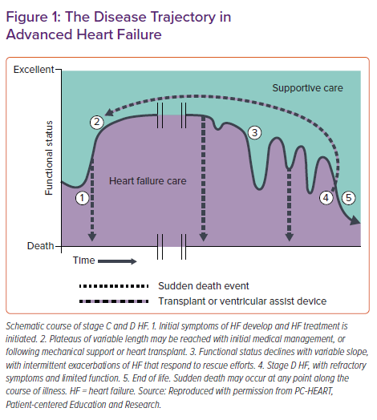
Thammana RV, Goodlin SJ
The Disease Trajectory in Advanced Heart Failure
Citation: Cardiac Failure Review 2022;8:e11.
https://doi.org/10.15420/cfr.2021.23

