Slide 1
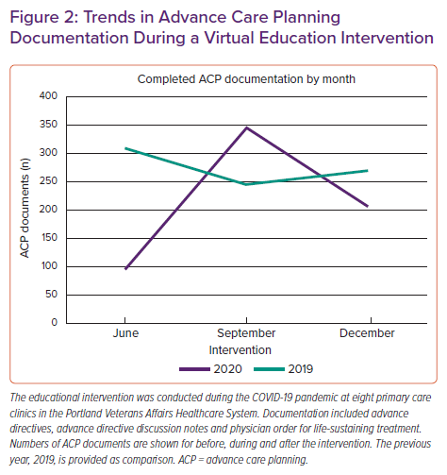
Thammana RV, Goodlin SJ
Trends in Advance Care Planning Documentation During a Virtual Education Intervention
Citation: Cardiac Failure Review 2022;8:e11.
https://doi.org/10.15420/cfr.2021.23

