Slide 1
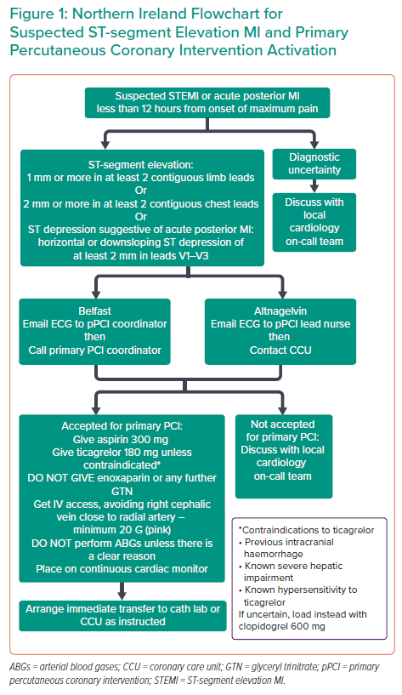
Olusan AA, Devlin P
Northern Ireland Flowchart for Suspected ST-segment Elevation MI and Primary Percutaneous Coronary Intervention Activation
Citation: Interventional Cardiology 2022;17:e04.
https://doi.org/10.15420/icr.2021.22

