Slide 1
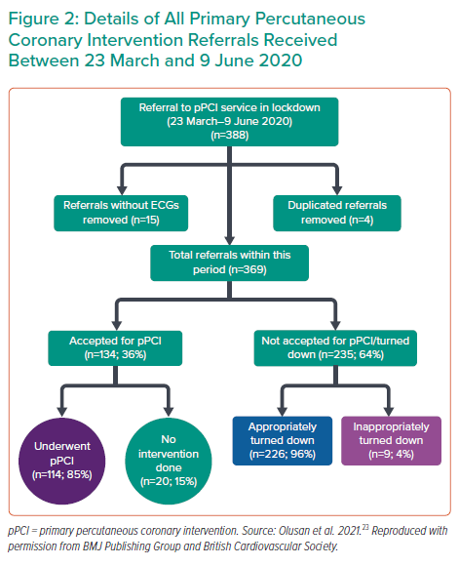
Olusan AA, Devlin P
Details of All Primary Percutaneous Coronary Intervention Referrals Received Between 23 March and 9 June 2020
Citation: Interventional Cardiology 2022;17:e04.
https://doi.org/10.15420/icr.2021.22

