Slide 1
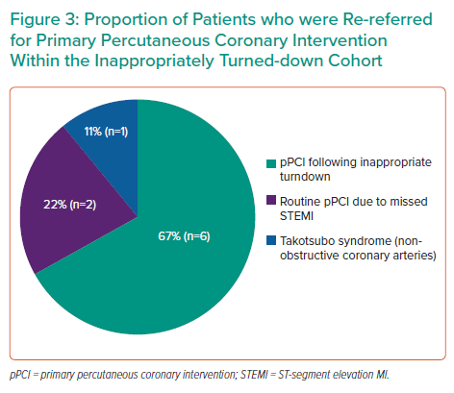
Olusan AA, Devlin P
Proportion of Patients who were Re-referred for Primary Percutaneous Coronary Intervention Within the Inappropriately Turned-down Cohort
Citation: Interventional Cardiology 2022;17:e04.
https://doi.org/10.15420/icr.2021.22

