Slide 1
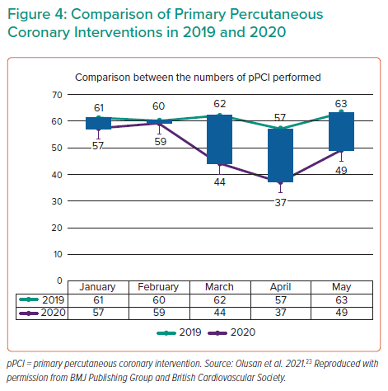
Olusan AA, Devlin P
Comparison of Primary Percutaneous Coronary Interventions in 2019 and 2020
Citation: Interventional Cardiology 2022;17:e04.
https://doi.org/10.15420/icr.2021.22

