Slide 1
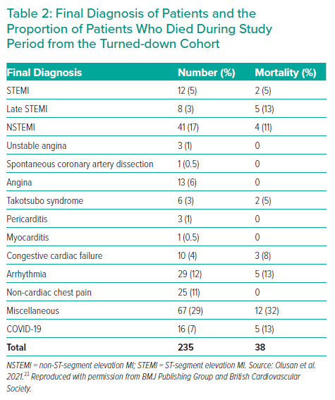
Olusan AA, Devlin P
Final Diagnosis of Patients and the Proportion of Patients Who Died During Study Period from the Turned-down Cohort
Citation: Interventional Cardiology 2022;17:e04.
https://doi.org/10.15420/icr.2021.22

