Slide 1
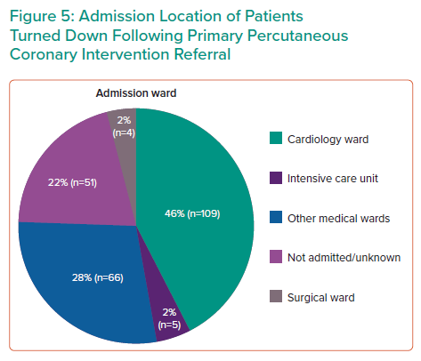
Olusan AA, Devlin P
Admission Location of Patients Turned Down Following Primary Percutaneous Coronary Intervention Referral
Citation: Interventional Cardiology 2022;17:e04.
https://doi.org/10.15420/icr.2021.22

