Slide 1
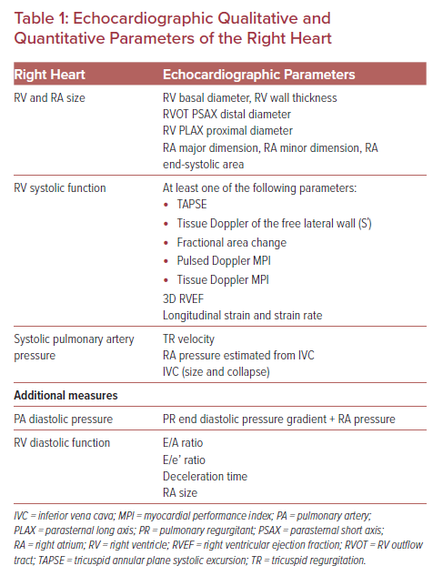
Tsipis A, Petropoulou E
Echocardiographic Qualitative and Quantitative Parameters of the Right Heart
Citation: US Cardiology Review 2022;16:e08.
https://doi.org/10.15420/usc.2021.03

