Slide 1
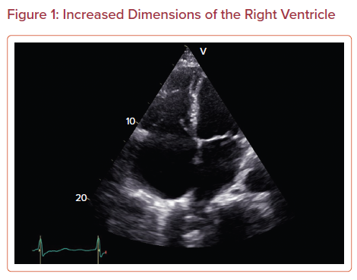
Tsipis A, Petropoulou E
Increased Dimensions of the Right Ventricle
Citation: US Cardiology Review 2022;16:e08.
https://doi.org/10.15420/usc.2021.03

