Slide 1
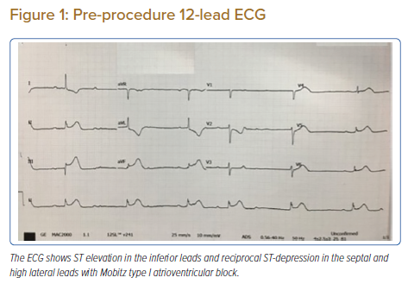
Neupane P, Hirachan A, Selvaraj K
Pre-procedure 12-lead ECG
Citation: Journal of Asian Pacific Society of Cardiology 2022;1:e08.
https://doi.org/10.15420/japsc.2021.15

