Slide 1
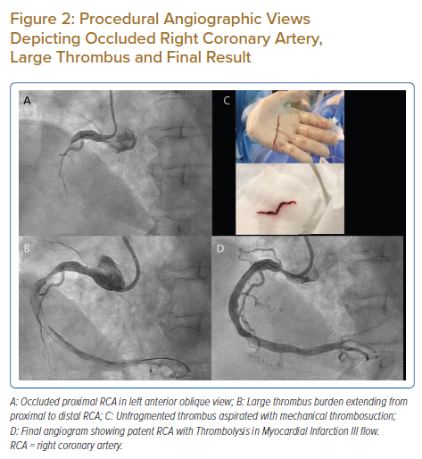
Neupane P, Hirachan A, Selvaraj K
Procedural Angiographic Views Depicting Occluded Right Coronary Artery, Large Thrombus and Final Result
Citation: Journal of Asian Pacific Society of Cardiology 2022;1:e08.
https://doi.org/10.15420/japsc.2021.15

