Slide 1
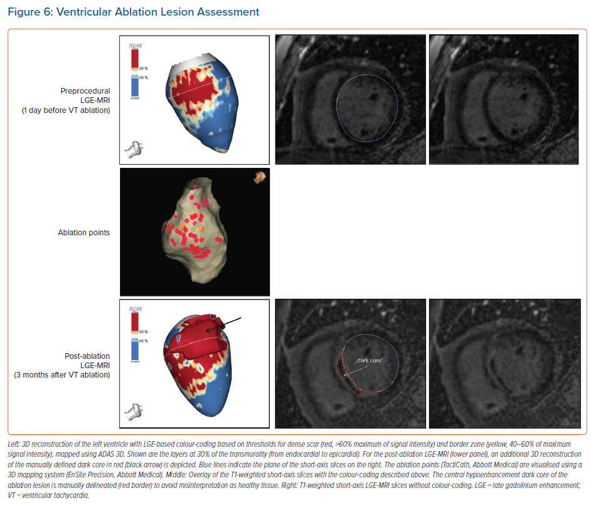
Mont L, Roca-Luque I, Althoff TF
Ventricular Ablation Lesion Assessment
Citation: Arrhythmia & Electrophysiology Review 2022;11:e02.
https://doi.org/10.15420/aer.2021.63

