Slide 1
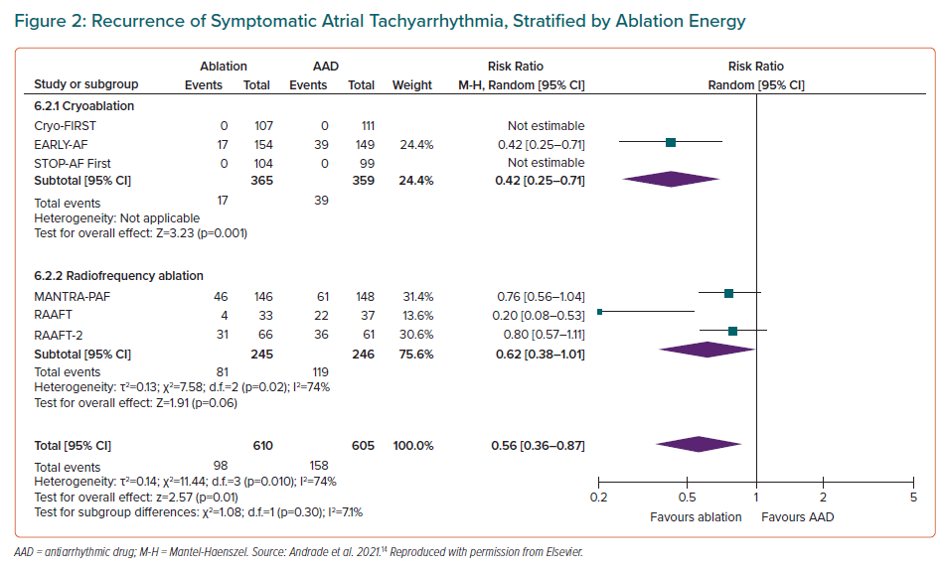
Andrade JG, Turgeon RD, Macle L, Deyell MW
Recurrence of Symptomatic Atrial Tachyarrhythmia, Stratified by Ablation Energy
Citation: European Cardiology Review 2022;17:e10.
https://doi.org/10.15420/ecr.2021.38

