Slide 1
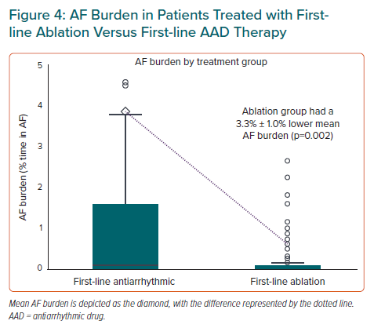
Andrade JG, Turgeon RD, Macle L, Deyell MW
AF Burden in Patients Treated with Firstline Ablation Versus First-line AAD Therapy
Citation: European Cardiology Review 2022;17:e10.
https://doi.org/10.15420/ecr.2021.38

