Slide 1
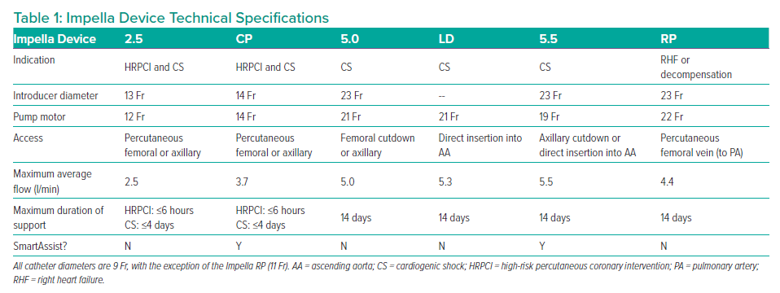
Zein R, Patel C, Mercado-Alamo A, Schreiber T, Kaki A
Impella Device Technical Specifications
Citation: Interventional Cardiology 2022;17:e05.
https://doi.org/10.15420/icr.2021.11

