Slide 1
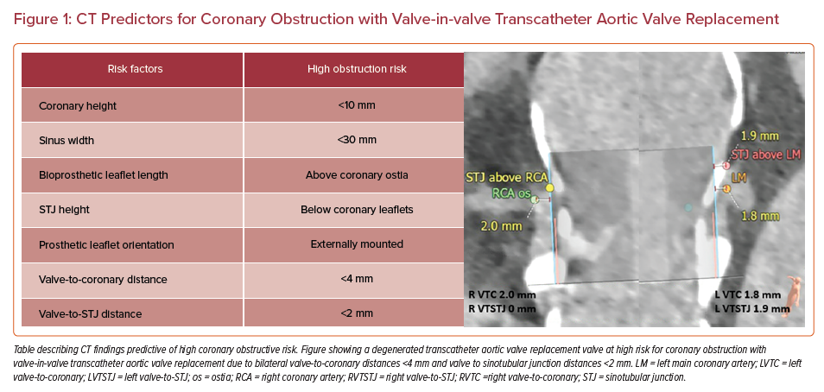
Perdoncin E, Paone G, Byku I
CT Predictors for Coronary Obstruction with Valve-in-valve Transcatheter Aortic Valve Replacement
Citation: US Cardiology Review 2022;16:e09.
https://doi.org/10.15420/usc.2021.20

