Slide 1
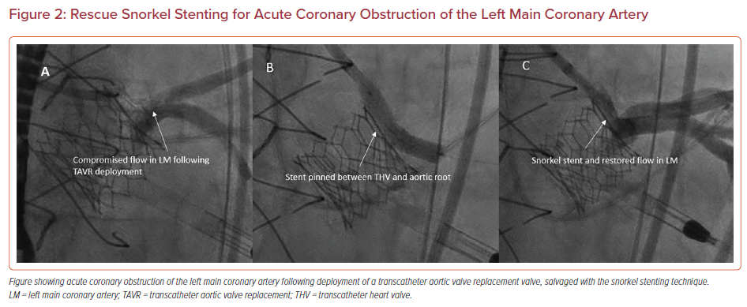
Perdoncin E, Paone G, Byku I
Rescue Snorkel Stenting for Acute Coronary Obstruction of the Left Main Coronary Artery
Citation: US Cardiology Review 2022;16:e09.
https://doi.org/10.15420/usc.2021.20

