Slide 1
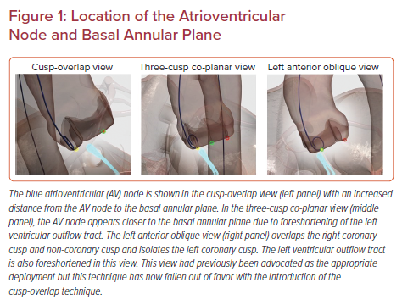
Siddique S, Khanal R, Vora AN, Gada H
Location of the Atrioventricular Node and Basal Annular Plane
Citation: US Cardiology Review 2022;16:e10.
https://doi.org/10.15420/usc.2021.24

