Slide 1
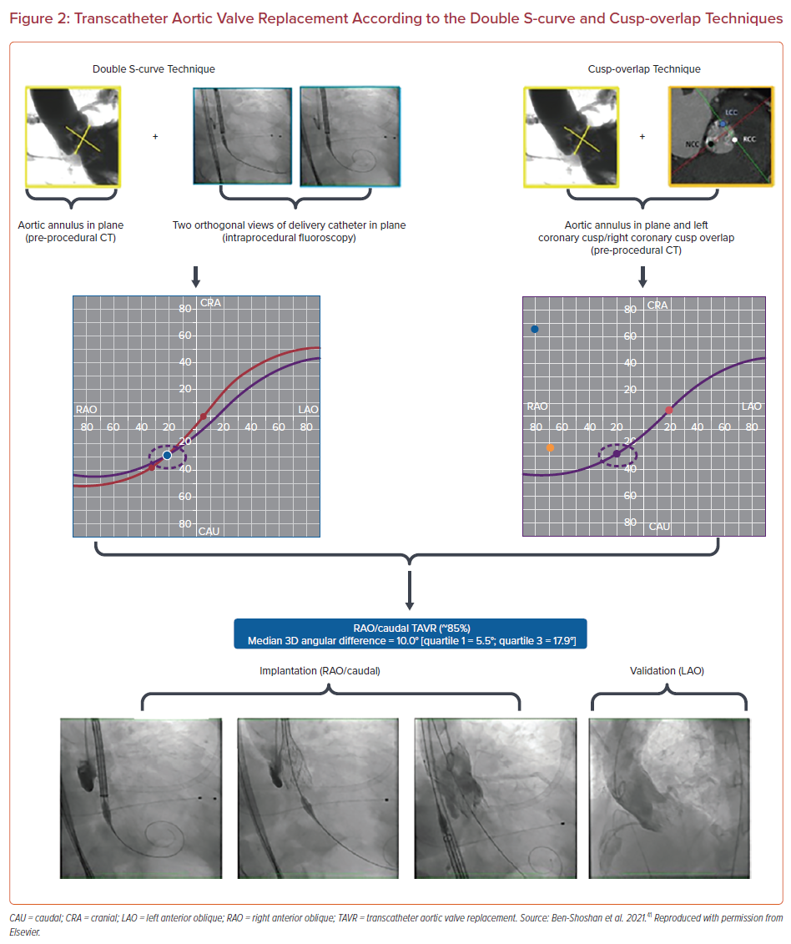
Siddique S, Khanal R, Vora AN, Gada H
Transcatheter Aortic Valve Replacement According to the Double S-curve and Cusp-overlap Techniques
Citation: US Cardiology Review 2022;16:e10.
https://doi.org/10.15420/usc.2021.24

