Slide 1
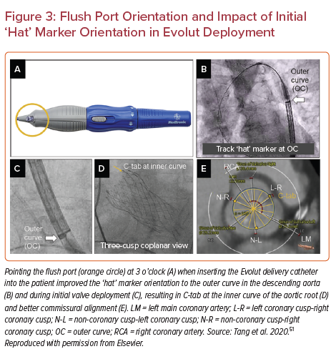
Siddique S, Khanal R, Vora AN, Gada H
Flush Port Orientation and Impact of Initial ‘Hat’ Marker Orientation in Evolut Deployment
Citation: US Cardiology Review 2022;16:e10.
https://doi.org/10.15420/usc.2021.24

