Slide 1
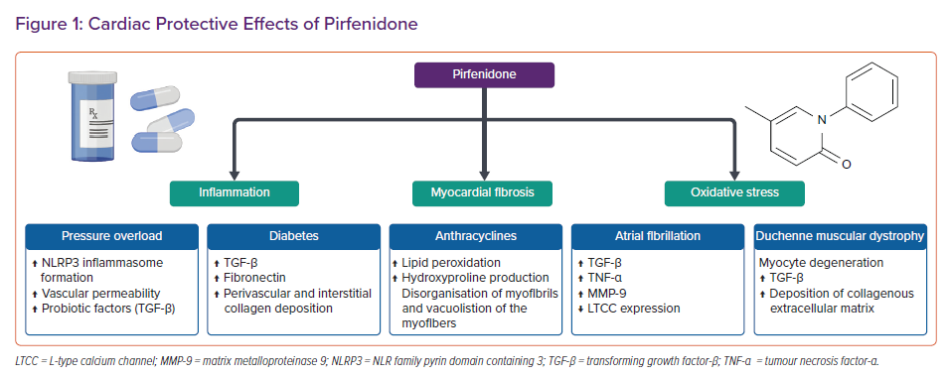
Aimo A, Spitaleri G, Nieri D, Tavanti LM, Meschi C, Panichella G, Lupón J, Pistelli F, Carrozzi L, Bayés-Genís A, Emdin M
Cardiac Protective Effects of Pirfenidone
Citation: Cardiac Failure Review 2022;8:e12.
https://doi.org/10.15420/cfr.2021.30

