Slide 1
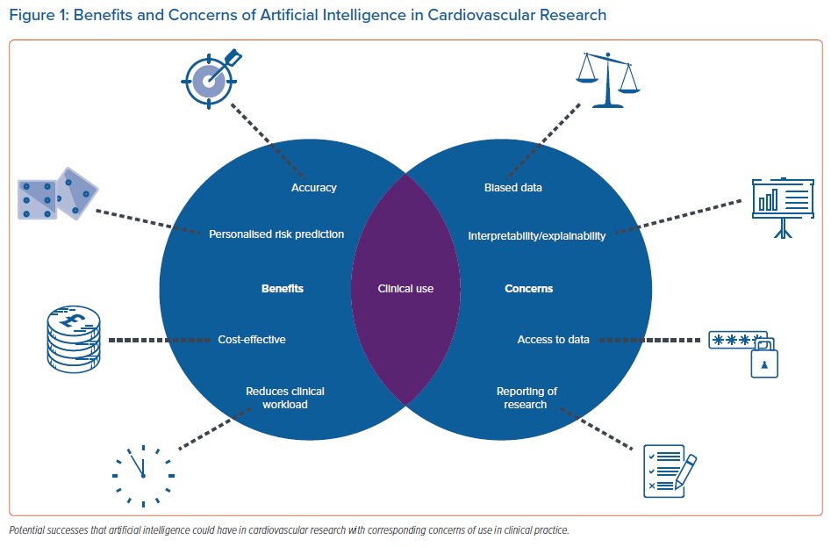
Shipley E, Joddrell M, Lip GY, Zheng Y
Benefits and Concerns of Artificial Intelligence in Cardiovascular Research
Citation: Arrhythmia & Electrophysiology Review 2022;11:e03.
https://doi.org/10.15420/aer.2022.07

