Slide 1
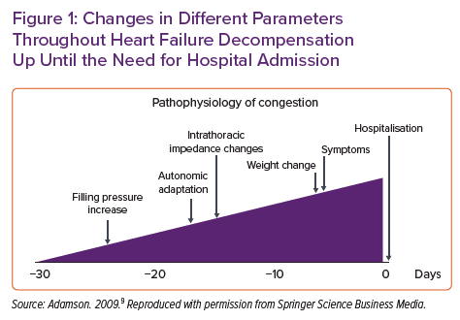
López-Azor JC, Torre Ndl, Carmena MDGC, Pérez PC, Munera C, Clement IM, León RC, Álvarez-García J, Pachón M, Ynsaurriaga FA, Bodes RS, Jiménez JFD, Bagudá JdJ
Changes in Different Parameters Throughout Heart Failure Decompensation Up Until the Need for Hospital Admission
Citation: Cardiac Failure Review 2022;8:e13.
https://doi.org/10.15420/cfr.2021.35

